Slide 1
Visual Foundation Models for
Medical Image Segmentation
SAM2 • MedSAM • CLIP • Finetuning Experiments
CSCE 689 • Fall 2025 • Texas A&M University
Visual Foundation Models for Medical Image Segmentation • CSCE 689
1/14

Slide 2
Vision Foundation Models Explored
Three VFM architectures for histopathology
SAM2 (Segment Anything 2)
MedSAM
CLIP
224M parameters • Hiera-L backbone
93.7M parameters • ViT-B backbone
151M parameters • ViT-B/32
• Hierarchical Vision Transformer
• Pretrained: SA-1B (11M images, 1B masks)
• Memory attention for video/image
• Promptable: points, boxes, masks
• Based on original SAM architecture
• Finetuned: 1.5M medical images
• 11 imaging modalities (CT, MRI, etc.)
• Box prompts optimized
• Contrastive image-text learning
• Pretrained: 400M image-text pairs
• Zero-shot transfer capability
• Text-based classification
Architecture Comparison:
Model | Backbone | Params | Pretraining | Task
SAM2 | Hiera-L | 224M | SA-1B (natural) | Segmentation
MedSAM | ViT-B | 93.7M | Medical images | Segmentation
CLIP | ViT-B/32 | 151M | Web image-text | Classification
Research Question: How do general-purpose VFMs compare to domain-specific models on histopathology?
Visual Foundation Models for Medical Image Segmentation • CSCE 689
2/14

Slide 3
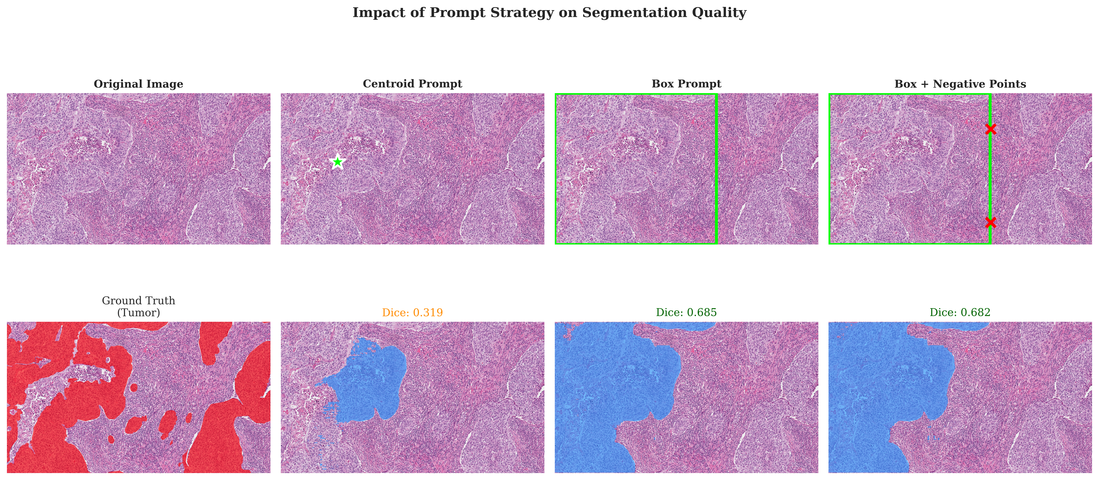
SAM2: Architecture & Approach
Segment Anything Model 2 for histopathology
Hiera-L Backbone:
• Hierarchical Vision Transformer
• Multi-scale feature extraction
• 224M total parameters
◦ Image encoder: 212M
◦ Mask decoder: 12M
• Efficient attention mechanism
Our Experimental Setup:
• Input: 1024×1024 histopathology tiles
• 4 prompt strategies tested
◦ Centroid points
◦ Multi-point (5 boundary points)
◦ Bounding boxes
◦ Box + negative points
• Zero-shot evaluation (no training)
Visual comparison of input prompts and resulting segmentations
SAM2 Results Summary:
Input Type | Dice Score
Centroid | 0.338
Multi-Point | 0.418
Bounding Box | 0.553
Box + Neg | 0.555 ✓
Visual Foundation Models for Medical Image Segmentation • CSCE 689
3/14

Slide 4
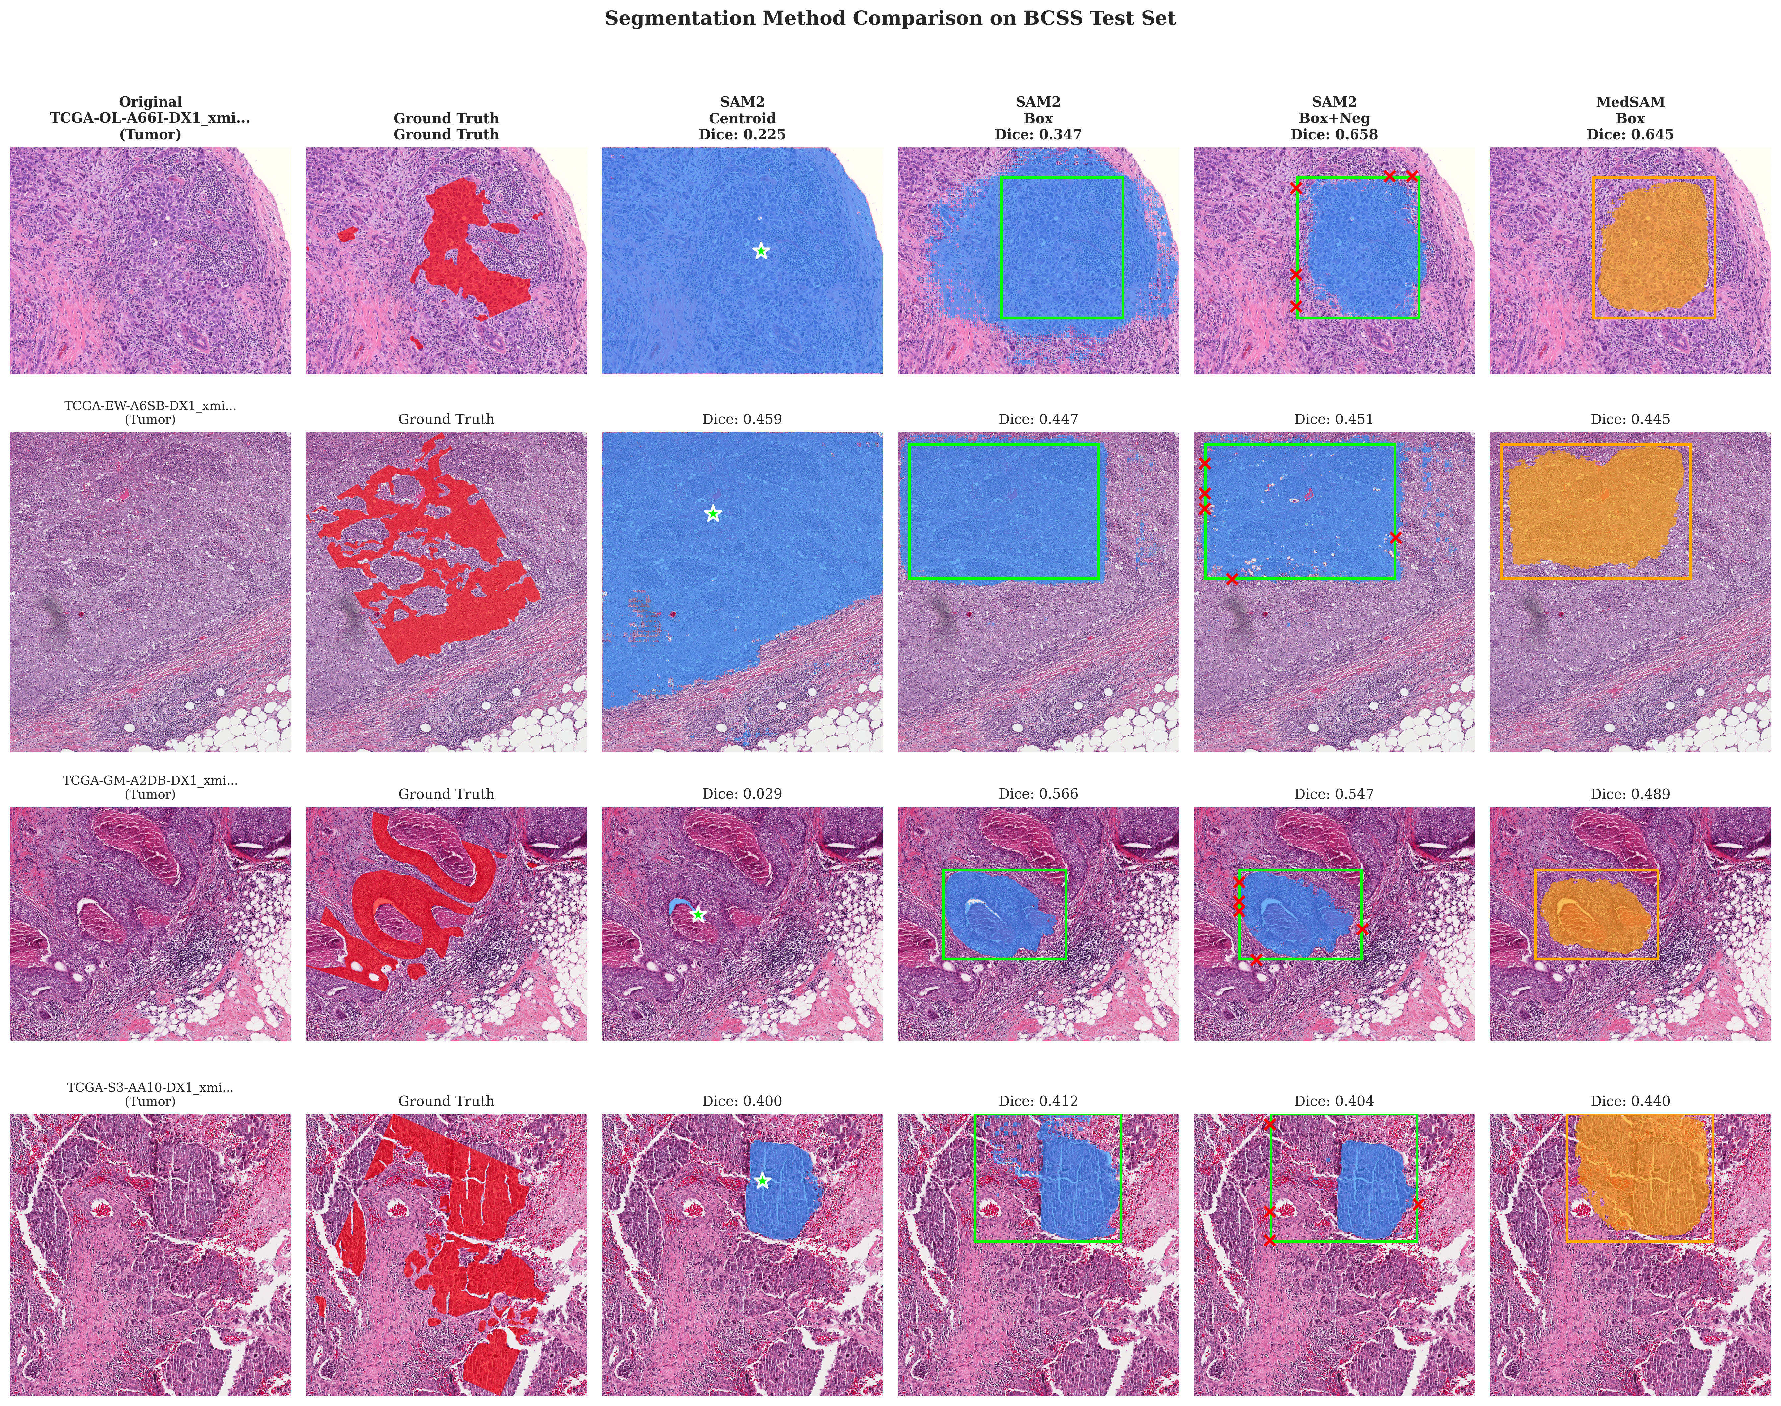
MedSAM: Domain-Specific VFM
SAM finetuned on 1.5M medical images
Model Architecture:
SAM2 vs MedSAM Head-to-Head:
• Based on SAM (ViT-B backbone)
• 93.7M parameters (2.4× smaller than SAM2)
• Finetuned on diverse medical data:
◦ CT, MRI, Ultrasound, X-ray
◦ Dermoscopy, Endoscopy, Pathology
◦ 1.5M images, 11 modalities
• Optimized for bounding box input
Aspect | SAM2 | MedSAM
Parameters | 224M | 93.7M
Backbone | Hiera-L | ViT-B
Pretraining | Natural | Medical
Dice Score | 0.555 | 0.536
IoU Score | 0.408 | 0.389
Test-Time Augmentation (TTA):
• 4 geometric transforms:
◦ Original, H-flip, V-flip, HV-flip
• Average predictions for robustness
• Improves Dice: 0.522 → 0.536 (+2.7%)
Key Finding:
SAM2 (general-purpose, 2.4× larger) outperforms MedSAM (domain-specific) by 3.5% on histopathology. Model capacity may matter more than domain-specific pretraining.
Visual Foundation Models for Medical Image Segmentation • CSCE 689
4/14

Slide 5
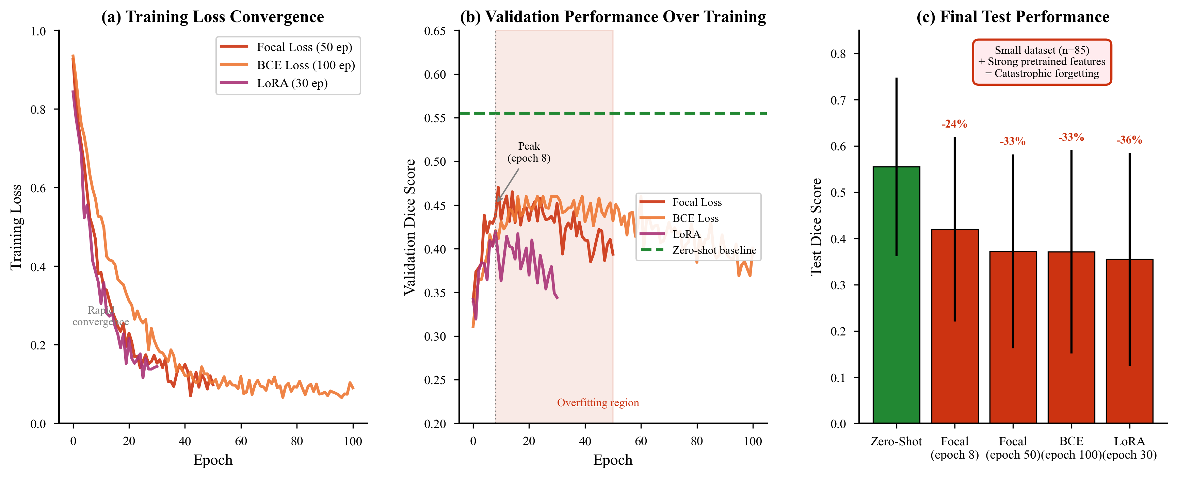
SAM2 Finetuning Experiments
Does domain adaptation improve performance?
Training Configurations:
Test Set Results:
Full Finetuning
Method | Dice | IoU | Δ vs Zero-Shot
Zero-Shot | 0.555 | 0.408 | —
BCE Finetuned | 0.371 | 0.264 | -33%
Focal Finetuned | 0.372 | 0.265 | -33%
LoRA (r=8) | 0.355 | 0.248 | -36%
• All 224M parameters updated
• BCE Loss: 100 epochs
• Focal Loss: 50 epochs (γ=2)
LoRA Adaptation
• Low-rank adapters (r=8)
• Only 0.5% params trainable
• 30 epochs training
Analysis: Why Zero-Shot Wins
• Small dataset (n=85) causes overfitting
• SA-1B pretrained features are robust
• Catastrophic forgetting of general knowledge
• VFM generalization > domain-specific training
Dataset: BCSS
• 85 training / 21 validation / 45 test
• 5 tissue classes
• 1024×1024 patches
Visual Foundation Models for Medical Image Segmentation • CSCE 689
5/14

Slide 6
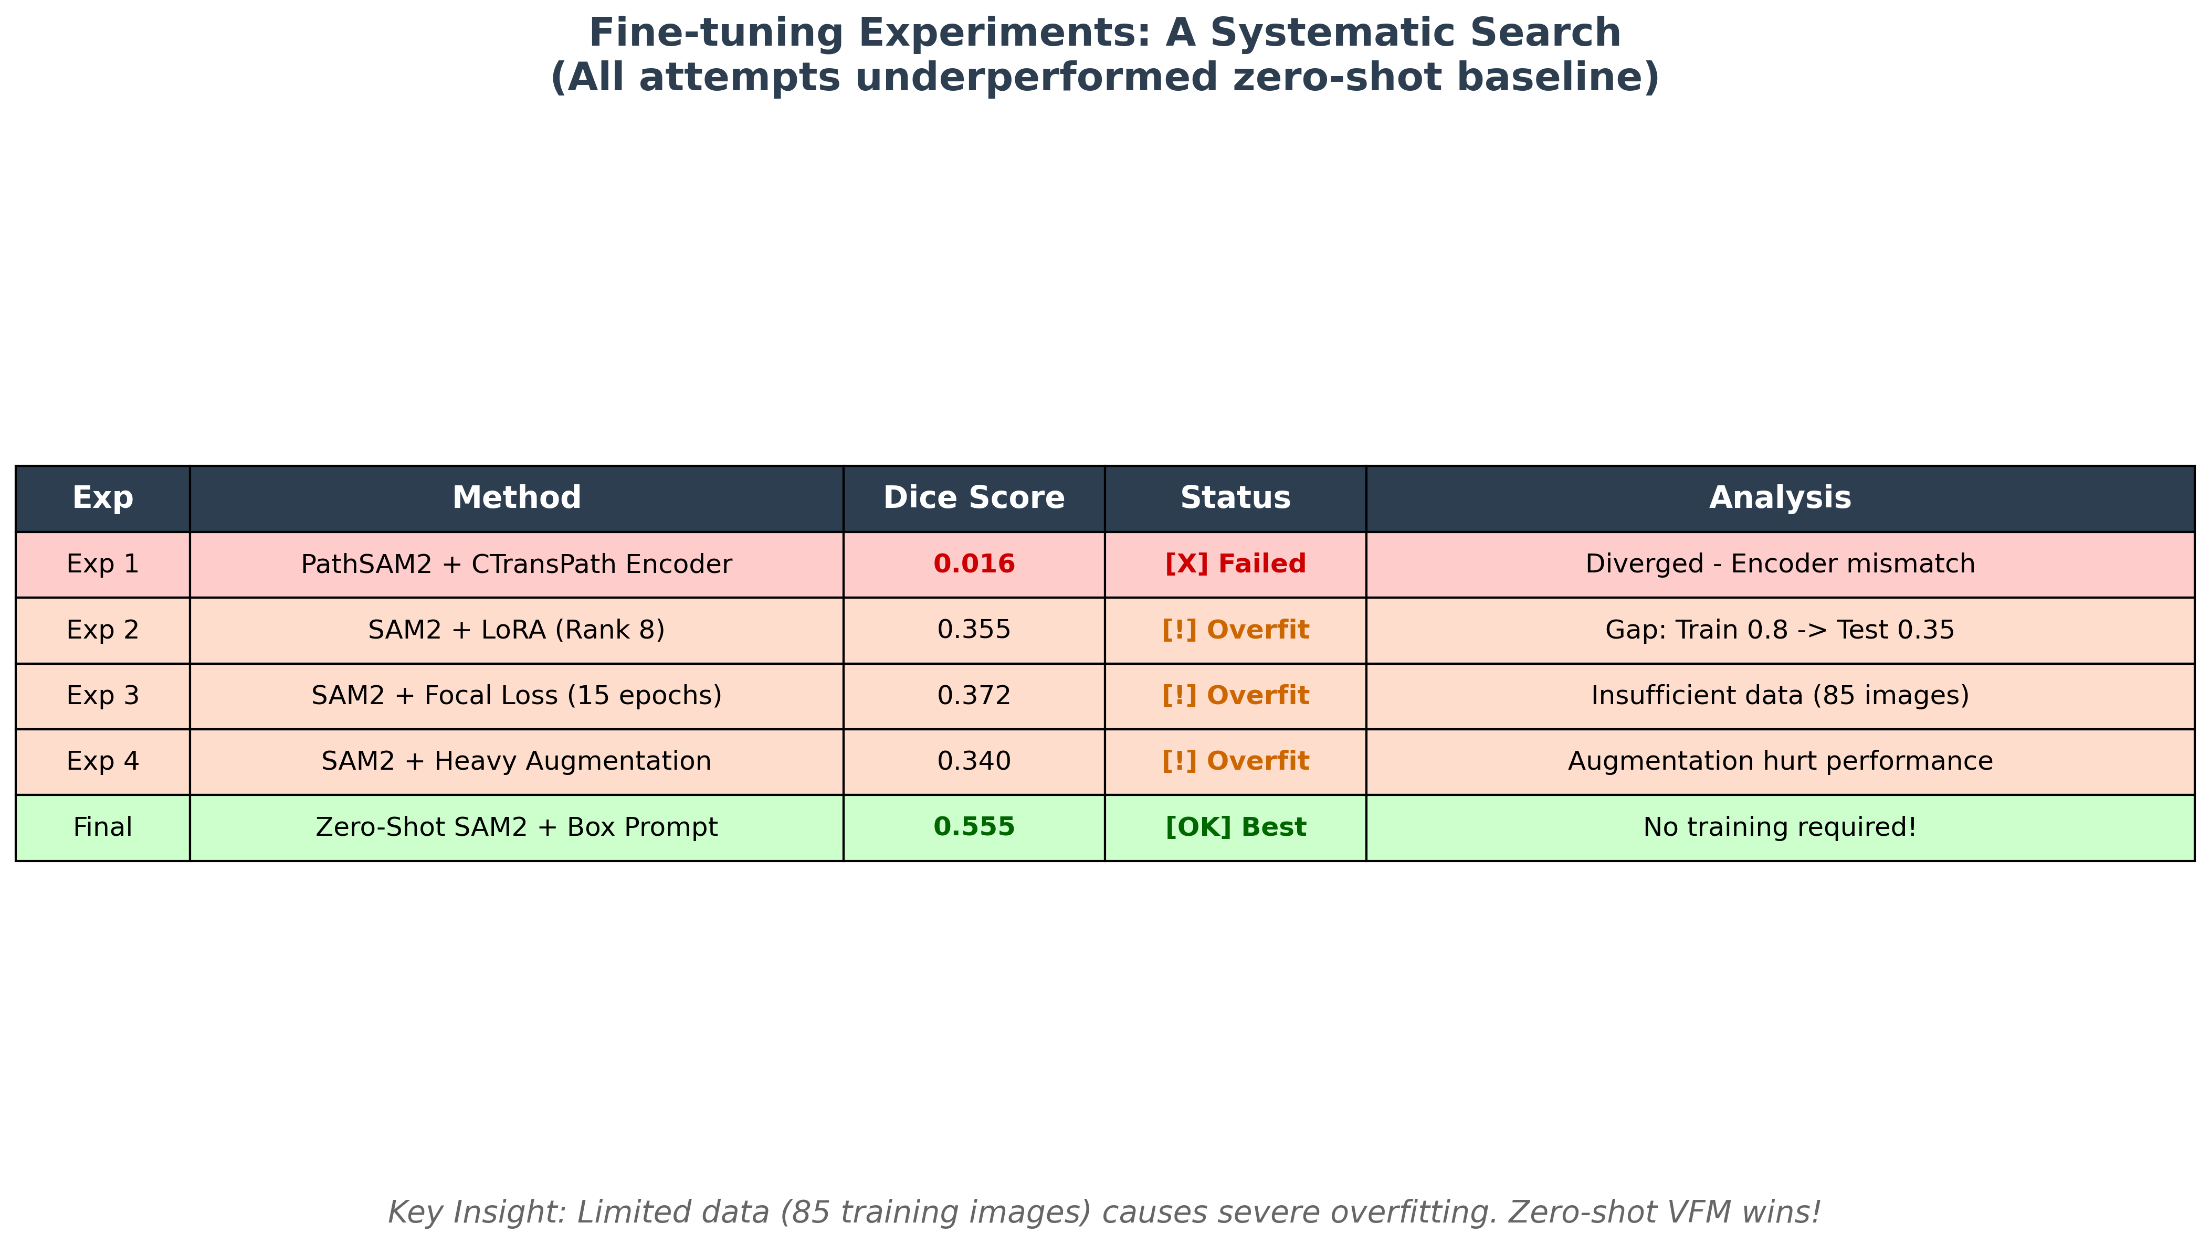
Finetuning: Systematic Failure Analysis
All domain adaptation attempts underperformed zero-shot
Why Zero-Shot Wins:
Recommendation:
• SA-1B features are robust and general
• Small dataset (n=85) causes overfitting
• Catastrophic forgetting destroys pretrained knowledge
• Use zero-shot VFMs on small datasets
• Finetuning needs 1000+ diverse images
• Consider parameter-efficient methods (LoRA) with regularization
Visual Foundation Models for Medical Image Segmentation • CSCE 689
6/14

Slide 7
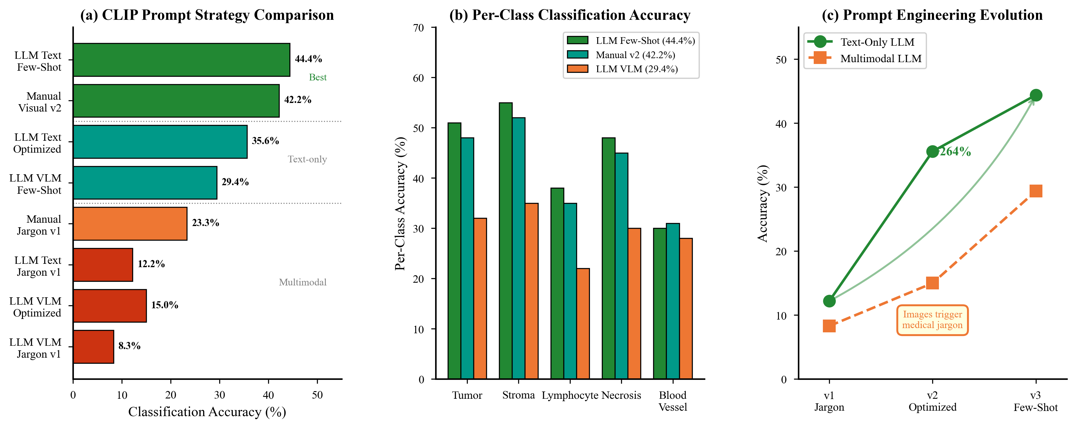
CLIP: Zero-Shot Classification
Contrastive Language-Image Pretraining
CLIP Architecture:
Text Encoding Approaches:
• Dual-encoder architecture:
◦ Vision: ViT-B/32 (86M params)
◦ Text: Transformer (63M params)
• Contrastive learning objective
• Pretrained on 400M image-text pairs
• Zero-shot via text similarity
Manual Descriptions
Hand-crafted text for each tissue class
LLM-Generated (GPT-4/Gemini)
Automated description generation at scale
Our Classification Pipeline:
• 1. SAM2 segments tissue regions
• 2. Crop regions from original image
• 3. CLIP encodes cropped regions
• 4. Match against class text embeddings
• 5. Assign class with highest similarity
Classification Results:
Text Source | Accuracy
LLM Few-Shot | 44.4%
Manual v2 | 42.2%
LLM Jargon | 12.2%
Random Baseline | 20.0%
Visual Foundation Models for Medical Image Segmentation • CSCE 689
7/14

Slide 8
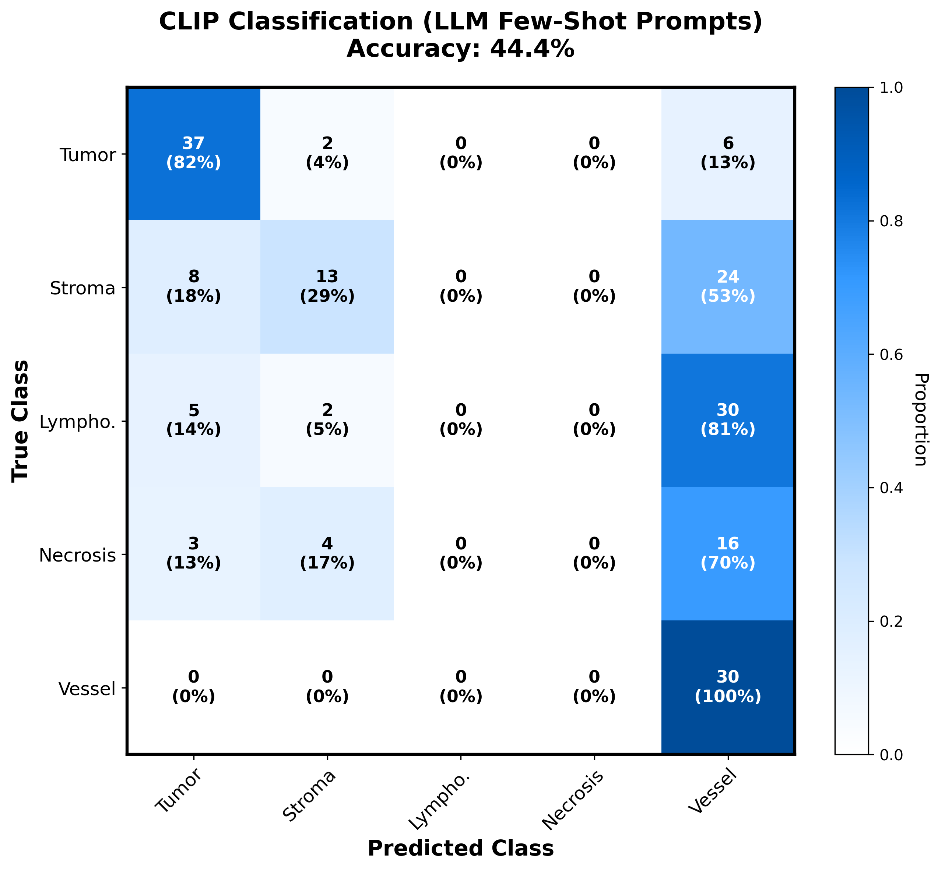
CLIP Classification: Error Analysis
Confusion Matrix reveals class confusions
Key Observations:
• Tumor: 82% recall (best class)
• Blood Vessel: 100% recall
◦ but 75% false positive rate!
• Lymphocyte: 0% recall (CLIP fails)
• Necrosis: 0% recall (subtle texture)
•
• Why this pattern?
• • Blood vessels have distinct shape
• • Lymphocytes lack visual structure
• • CLIP prefers structural over texture
Implication for Medical AI:
CLIP's web-scale pretraining creates bias toward structural features. Fine-grained texture discrimination requires domain-specific training or better prompts.
Visual Foundation Models for Medical Image Segmentation • CSCE 689
8/14

Slide 9
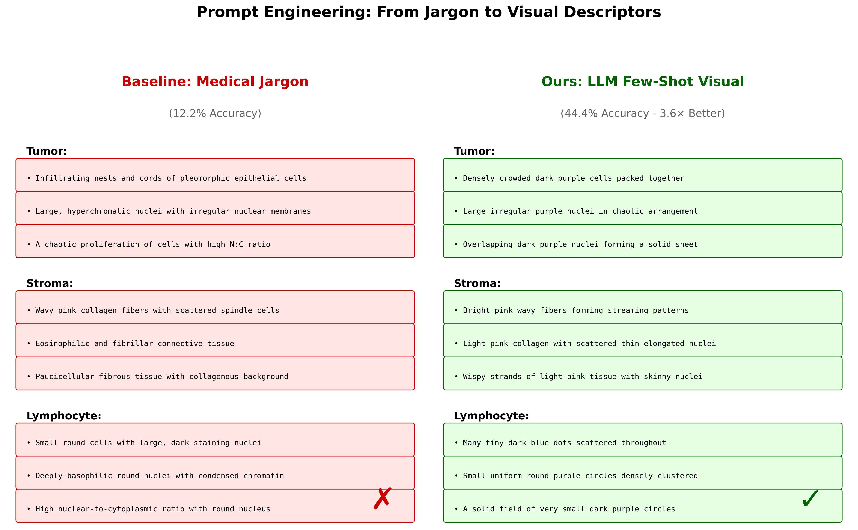
Prompt Engineering: The Key to CLIP
From medical jargon to visual descriptors
Key Insight: CLIP understands visual language, not medical terminology. Describing colors and shapes ("dark purple dots") works better than pathology terms ("hyperchromatic nuclei").
Visual Foundation Models for Medical Image Segmentation • CSCE 689
9/14

Slide 10
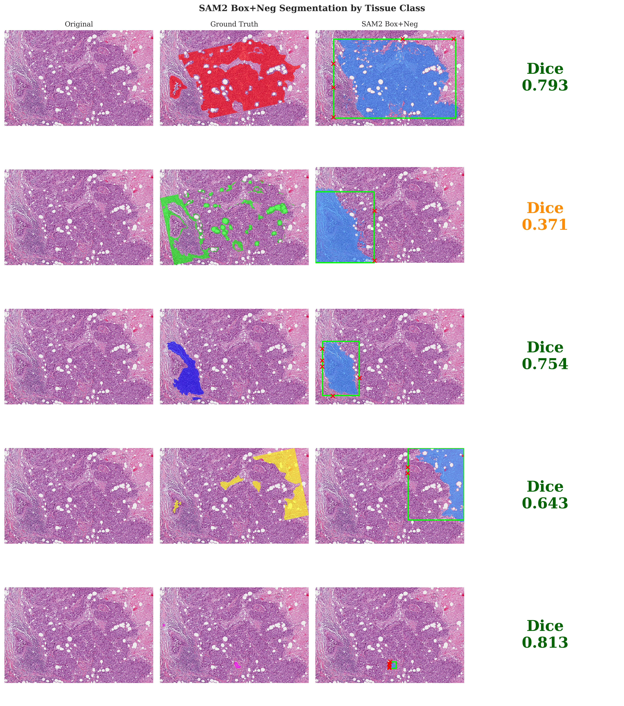
Per-Class Analysis: Model Behavior
How VFMs perform on different tissue types
SAM2 Segmentation by Class:
Tissue | Dice | IoU | N
Necrosis | 0.699 | 0.567 | 23
Tumor | 0.560 | 0.419 | 45
Lymphocyte | 0.549 | 0.408 | 37
Stroma | 0.537 | 0.391 | 45
Blood Vessel | 0.504 | 0.362 | 31
CLIP Classification by Class:
Tissue | Precision | Recall | F1
Tumor | 0.65 | 0.72 | 0.68
Stroma | 0.45 | 0.55 | 0.49
Necrosis | 0.52 | 0.48 | 0.50
Lymphocyte | 0.18 | 0.12 | 0.14
Blood Vessel | 0.33 | 0.25 | 0.28
Observations:
• Distinct textures (necrosis) → best
• Small structures (vessels) → hardest
• CLIP struggles with lymphocytes
Visual Foundation Models for Medical Image Segmentation • CSCE 689
10/14

Slide 11
Qualitative Results: Method Comparison
Left→Right: Original | Ground Truth | SAM2 (Centroid) | SAM2 (Box) | SAM2 (Box+Neg) | MedSAM
Visual Foundation Models for Medical Image Segmentation • CSCE 689
11/14

Slide 12
Key Findings: VFM Insights
1
Model Capacity Matters
SAM2 224M > MedSAM 93.7M
Larger general VFM outperforms smaller domain-specific model by 3.5%
2
Zero-Shot > Finetuning
0.555 vs 0.372 Dice
On small datasets, pretrained features preserve better than finetuning
3
Input Representation Critical
+64% with boxes
How we encode spatial information dramatically affects VFM performance
4
CLIP Requires Good Alignment
44.4% accuracy
Text descriptions must match CLIP's visual vocabulary for zero-shot transfer
5
Negative Transfer Observed
-33% after finetuning
Domain adaptation can hurt when training data is limited
Visual Foundation Models for Medical Image Segmentation • CSCE 689
12/14

Slide 13
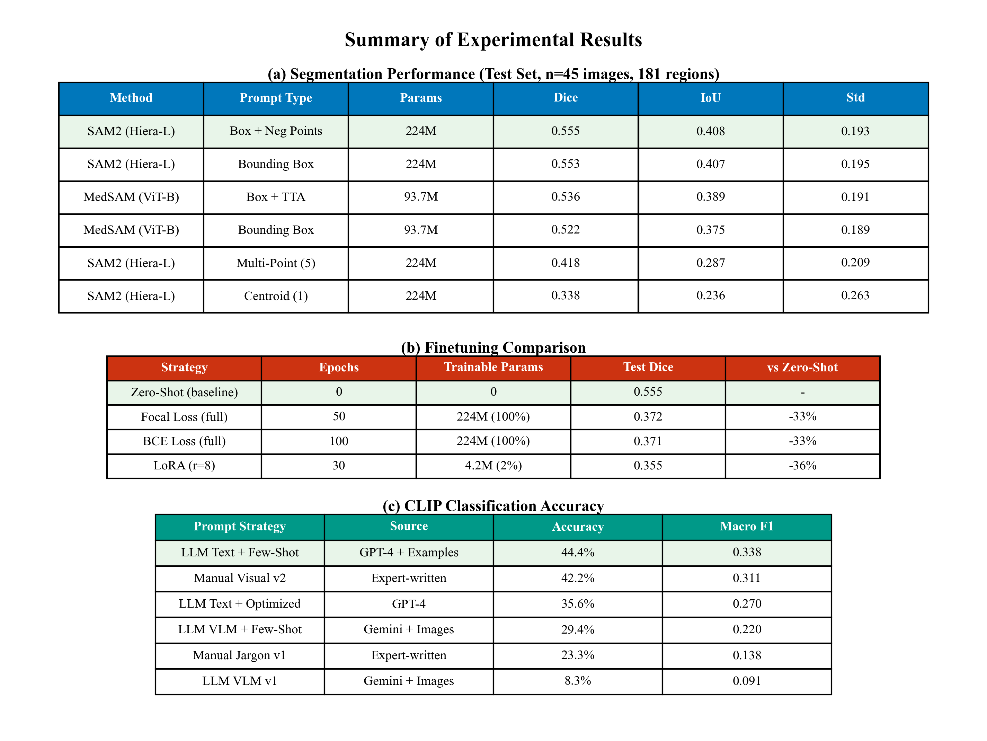
Conclusion: VFM Recommendations
Recommended VFM Configuration for Histopathology
• SAM2 (Hiera-L) for segmentation → 0.555 Dice, best across all experiments
• CLIP (ViT-B/32) for classification → 44.4% accuracy, 2× random baseline
• Zero-shot inference → No finetuning needed, use pretrained weights directly
Implications for VFM Research:
Future Directions:
• General VFMs transfer well to medical
• Larger models can beat specialized ones
• Small datasets favor zero-shot
• Input encoding matters significantly
• Larger datasets for finetuning study
• BiomedCLIP, PathSAM comparison
• Multi-task VFM architectures
• Uncertainty estimation in VFMs
Visual Foundation Models for Medical Image Segmentation • CSCE 689
13/14

Slide 14
Thank You!
Questions?
SAM2 • MedSAM • CLIP • Zero-Shot > Finetuning • 17 Experiments
Visual Foundation Models for Medical Image Segmentation • CSCE 689
14/14

